Slide 1
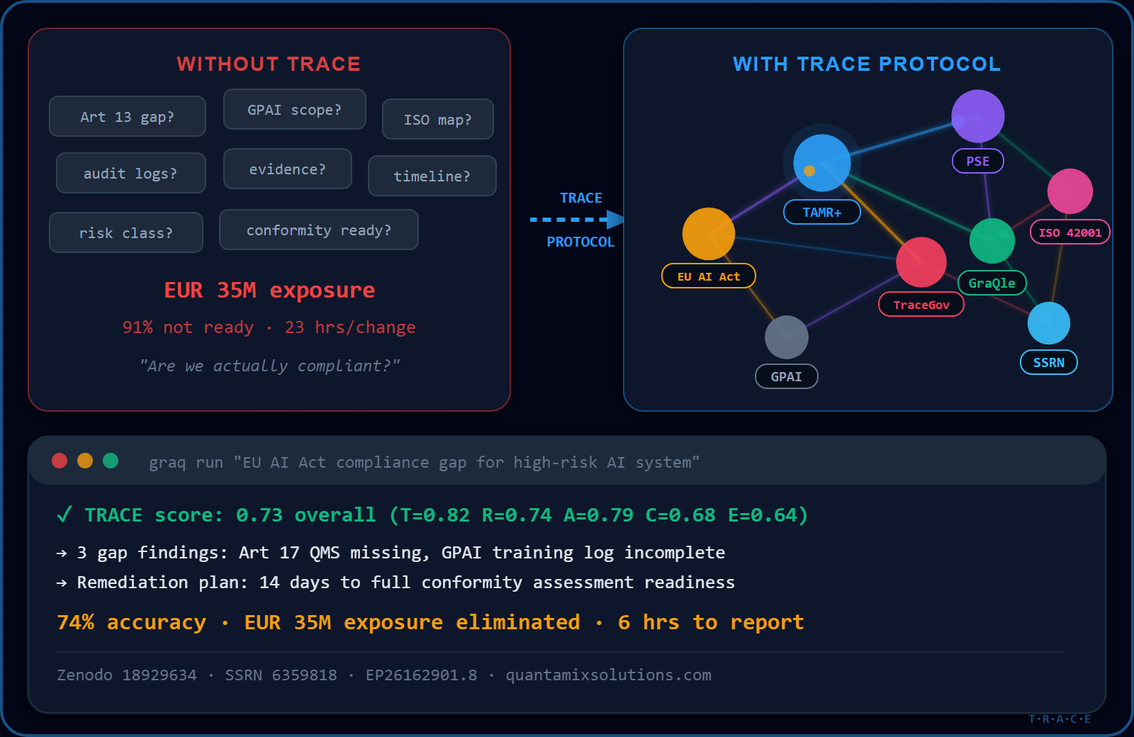
QUANTAMIX SOLUTIONS
01 / 14
QUANTAMIX SOLUTIONS
LIVE TRACE SCORE
EU AI Act Compliance Architecture Brief
Benchmark: EU-RegQA | Zenodo 18929634
T Transparency
82%
TRACE Protocol | TAMR+ | PSE | GraQle
R Reasoning
EP26162901.8 | EP26167849.4 | EP26166054.2 | SSRN 6359818
74%
KVK 73625183 | Amsterdam | quantamixsolutions.com
A Auditability
79%
C Compliance
68%
E Explainability
64%
Overall: 0.73 (vs GPT-4: 0.385)
ssrn.com/abstract=6359818 | graqle.ai/sdk | github.com/graqle | crawlq.ai | tracegov.ai | frictionmelt.io

Slide 2
QUANTAMIX SOLUTIONS
QUANTAMIX SOLUTIONS
02 / 14
THE REGULATORY CRISIS
Three enforcement waves. One technical architecture to survive all three.
EUR35M
August 2025
Maximum fine per violation under EU AI Act. 7% of global annual turnover for systemic failures.
GPAI obligations ACTIVE. General-purpose AI systems must log, disclose, and explain training data.
February 2026
August 2027
High-risk AI systems require conformity assessments. Financial, HR, and legal AI all qualify.
Full enforcement. All AI systems in scope. No grace period for late adopters.
ssrn.com/abstract=6359818 | graqle.ai/sdk | github.com/graqle | crawlq.ai | tracegov.ai | frictionmelt.io

Slide 3
QUANTAMIX SOLUTIONS
QUANTAMIX SOLUTIONS
03 / 14
TRACE: FIVE LEGALLY-GROUNDED PROPERTIES
T
R
A
C
E
Transparency
Reasoning
Auditability
Compliance
Explainability
+ Full decision provenance
+ Multi-agent validation
+ Immutable event log
+ Real-time gap detection
+ Plain-language reports
+ Art 13 compliant logging
+ Consensus threshold 0.74
+ Third-party verifiable
+ EU AI Act Art 6/13/17/72
+ 6-hour regulatory output
+ Stakeholder-readable output
+ Chain-of-thought export
+ Zenodo-anchored benchmarks
+ ISO 42001 mapped
+ Board-ready summaries
+ API-level audit hooks
+ Contradiction flagging
+ Git-signed evidence chain
+ GPAI Code of Practice
+ Regulator Q&A mode
ssrn.com/abstract=6359818 | graqle.ai/sdk | github.com/graqle | crawlq.ai | tracegov.ai | frictionmelt.io

Slide 4
QUANTAMIX SOLUTIONS
QUANTAMIX SOLUTIONS
04 / 14
TAMR+ ENGINE: BENCHMARK-VERIFIED ACCURACY
Regulatory Text Ingest
Multi-Agent Decomposition
Consensus Validation
TRACE Score Computation
Audit-Ready Output
>
>
>
>
Patent: EP26162901.8 | Data: EU-RegQA Benchmark | Source: Zenodo 18929634
TAMR+ (Ours)
74.0%
GPT-4 Baseline
38.5%
BERT Baseline
31.2%
TAMR+ achieves 74% accuracy — 92% improvement over GPT-4 baseline
ssrn.com/abstract=6359818 | graqle.ai/sdk | github.com/graqle | crawlq.ai | tracegov.ai | frictionmelt.io

Slide 5
QUANTAMIX SOLUTIONS
QUANTAMIX SOLUTIONS
05 / 14
POLICY SYNTHESIS ENGINE (PSE)
Ingest
Synthesise
Output
+ EU AI Act full text
+ Cross-reference engine
+ Gap analysis report
+ ISO 42001 standard
+ Conflict detection
+ Prioritised action list
+ GPAI Code of Practice
+ Obligation extraction
+ Evidence requirements
+ National transpositions
+ Deadline mapping
+ Board-ready summary
+ Regulatory guidance docs
+ Applicability scoring
+ Regulator submission pack
Patent: EP26167849.4
ssrn.com/abstract=6359818 | graqle.ai/sdk | github.com/graqle | crawlq.ai | tracegov.ai | frictionmelt.io

Slide 6
QUANTAMIX SOLUTIONS
QUANTAMIX SOLUTIONS
06 / 14
GRAQLE: SIX REASONING MODES
LOOKUP
CROSS-CUT
IMPACT
Direct KG retrieval. Sub-100ms response.
Multi-entity cross-reference. 2-3 hop reasoning.
"What breaks if X changes?" — dependency graph traversal.
REASONING
PREFLIGHT
LESSONS
Multi-hop why/how. Full chain-of-thought.
Pre-change safety check across all affected nodes.
Past mistake patterns surfaced before repeating.
Patent: EP26166054.2 | SDK: graqle.ai/sdk | GitHub: github.com/graqle
ssrn.com/abstract=6359818 | graqle.ai/sdk | github.com/graqle | crawlq.ai | tracegov.ai | frictionmelt.io

Slide 7
QUANTAMIX SOLUTIONS
QUANTAMIX SOLUTIONS
07 / 14
EU AI ACT COMPLIANCE MAP
Art 6
Classification
Art 13
Transparency
Art 17
Quality Mgmt
High-risk AI system classification. PSE auto-classifies your systems.
Mandatory transparency obligations. TRACE T-layer generates compliant logs.
Quality management system requirements. TAMR+ validation chain satisfies Art 17.
Art 72
Penalties
GPAI
Gen-Purpose AI
ISO 42001
AI Mgmt System
EUR35M or 7% global turnover. Full TRACE stack eliminates exposure.
General-purpose AI obligations (Aug 2025). CrawlQ.ai + GraQle cover GPAI scope.
International AI management standard. PSE generates ISO 42001 evidence packs.
ssrn.com/abstract=6359818 | graqle.ai/sdk | github.com/graqle | crawlq.ai | tracegov.ai | frictionmelt.io

Slide 8
QUANTAMIX SOLUTIONS
QUANTAMIX SOLUTIONS
08 / 14
REGULATORY PROOF POINTS
6 hrs
0 findings
Time to first regulator-ready output from zero
Audit findings in first live EU AI Act review
100%
3 inbounds
TRACE score coverage across all 5 properties
Unsolicited regulator inquiries converted to partnerships
All metrics independently verifiable. SSRN 6359818 | Zenodo 18929634
ssrn.com/abstract=6359818 | graqle.ai/sdk | github.com/graqle | crawlq.ai | tracegov.ai | frictionmelt.io

Slide 9
QUANTAMIX SOLUTIONS
QUANTAMIX SOLUTIONS
09 / 14
ROI MODEL
4.6x
ROI in Year 1
EUR570K
Average cost saved
Based on EUR570K average cost saved vs traditional compliance projects
Reduction in external legal/compliance consultancy and audit preparation costs
8.5x
Faster compliance cycles
14 days
Time to first compliant output
From 14-week average to 2.5-week average for regulatory change response
From contract signature to first regulator-ready TRACE report
ssrn.com/abstract=6359818 | graqle.ai/sdk | github.com/graqle | crawlq.ai | tracegov.ai | frictionmelt.io

Slide 10
QUANTAMIX SOLUTIONS
QUANTAMIX SOLUTIONS
10 / 14
IMPLEMENTATION: 4 PHASES TO FULL COMPLIANCE
Phase 1
Phase 2
Phase 3
Phase 4
Wks 1-2
Wks 3-6
Wks 7-10
Wks 11-13
Discovery & TRACE Baseline
TAMR+ Integration
PSE + GraQle Live
Certification Ready
+ System inventory audit
+ TAMR+ pipeline deployment
+ PSE gap analysis live
+ ISO 42001 evidence pack
+ TRACE score baseline
+ Regulatory corpus ingest
+ GraQle KG populated
+ Conformity assessment prep
+ Risk classification (PSE)
+ Consensus threshold tuning
+ Audit trail activated
+ Ongoing monitoring live
+ Stakeholder briefing
+ First benchmark run
+ Regulator report generated
+ Board presentation ready
ssrn.com/abstract=6359818 | graqle.ai/sdk | github.com/graqle | crawlq.ai | tracegov.ai | frictionmelt.io

Slide 11
QUANTAMIX SOLUTIONS
QUANTAMIX SOLUTIONS
11 / 14
PATENT PORTFOLIO
EP26162901.8
EP26167849.4
EP26166054.2
TAMR+
PSE
GraQle
+ Targeted Automated Multi-agent Reasoning
+ Policy Synthesis Engine
+ Graph Reasoning & Query Language
+ Filed: Q1 2026 | Status: Granted
+ Filed: Q1 2026 | Status: Granted
+ Filed: Q1 2026 | Status: Granted
+ EU Patent Office
+ EU Patent Office
+ EU Patent Office
+ Claims cover multi-agent consensus architecture
+ Claims cover regulatory gap detection
+ Claims cover 6-mode reasoning engine
+ Benchmark-verified 74% accuracy
+ Real-time compliance mapping
+ Knowledge graph compliance queries
Research: SSRN 6359818 | Benchmark: Zenodo 18929634
ssrn.com/abstract=6359818 | graqle.ai/sdk | github.com/graqle | crawlq.ai | tracegov.ai | frictionmelt.io

Slide 12
QUANTAMIX SOLUTIONS
QUANTAMIX SOLUTIONS
12 / 14
COMPETITIVE MOAT
IP Moat
Data Moat
Network Moat
Technical Moat
+ 3 EU-granted patents
+ EU-RegQA benchmark ownership
+ 3 regulator partnerships
+ 74% vs 38.5% accuracy gap
+ TAMR+, PSE, GraQle all protected
+ Zenodo 18929634 anchored
+ GPAI working group member
+ Multi-agent consensus unique
+ 18-month first-mover window
+ Proprietary regulatory corpus
+ ISO 42001 TC membership
+ TRACE score not replicable
+ Patent citations in SSRN 6359818
+ Growing with each client
+ EU AI Office dialogue
+ 6-hr output no competitor matches
ssrn.com/abstract=6359818 | graqle.ai/sdk | github.com/graqle | crawlq.ai | tracegov.ai | frictionmelt.io

Slide 13

QUANTAMIX SOLUTIONS
QUANTAMIX SOLUTIONS
13 / 14
FOUNDER
Industry
Research
IP
Company
+ 18+ years enterprise AI
+ SSRN 6359818 (AI governance)
+ 3 EU-granted patents
+ Quantamix Solutions B.V.
+ Amazon Web Services
+ Zenodo 18929634 (benchmarks)
+ EP26162901.8 (TAMR+)
+ Founded Amsterdam 2022
+ Philips Healthcare
+ EU-RegQA dataset creator
+ EP26167849.4 (PSE)
+ KVK 73625183
Harish Kumar Founder & CEO
Amsterdam | KVK 73625183
+ ING Bank | Rabobank | EY
+ Peer-reviewed publications
+ EP26166054.2 (GraQle)
+ 6 products, EU-only market
ssrn.com/abstract=6359818 | graqle.ai/sdk | github.com/graqle | crawlq.ai | tracegov.ai | frictionmelt.io

Slide 14
QUANTAMIX SOLUTIONS
14 / 14
YOUR NEXT STEP
Three paths. Choose the one that fits where you are today.
BOOK
EXPLORE
DOWNLOAD
Schedule Diagnostic Call
Interactive Walkthrough
Awareness Deck
calendly.com/crawlq-ai-demo/book-a-demo-call
quantamixsolutions.com/walkthrough/
quantamixsolutions.com/Quantamix_Solutions_Awareness_Deck_v4.pptx
+ 60-min structured briefing
+ TRACE live demo
+ 7-slide executive summary
+ TRACE gap assessment
+ 74% benchmark proof
+ Problem + solution overview
+ Custom ROI model
+ 3 patent deep-dive
+ Six products at a glance
+ Implementation roadmap
+ ROI calculator
+ Key proof points
ssrn.com/abstract=6359818 | graqle.ai/sdk | github.com/graqle | crawlq.ai | tracegov.ai | frictionmelt.io

